Slide 1









Project Overview & Objectives
Data Sources & Quality
Data Cleaning Process
Power BI DAX Measures
Superstore Sales Data Analysis
Power BI Dashboards
Key Metrics & Segments
Region and City Performance
Top Customers & Behavior
Best & Worst Products
Insights & Challenges
Next Steps

Slide 2
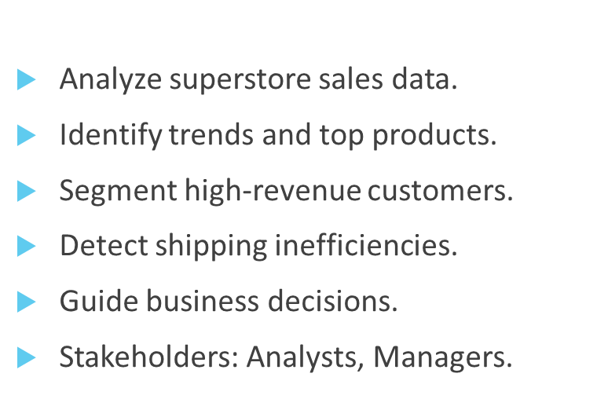
Project Overview & Objectives
Data Sources & Quality
Data Cleaning Process
Power BI DAX Measures
Superstore Sales Data Analysis
Power BI Dashboards
Key Metrics & Segments
Region and City Performance
Top Customers & Behavior
Best & Worst Products
Insights & Challenges
Next Steps

Slide 3
Project Overview & Objectives
Data Sources & Quality
Data Cleaning Process
Data from the retail transaction system.
Includes sales and customer info.
No critical missing values.
Minor name duplications.
Consistent date formatting.
Covers 2015 to 2018.
Power BI DAX Measures
Superstore Sales Data Analysis
Power BI Dashboards
Key Metrics & Segments
Region and City Performance
Top Customers & Behavior
Best & Worst Products
Insights & Challenges
Next Steps

Slide 4
Project Overview & Objectives
Data Sources & Quality
Data Cleaning Process
Used the pandas library.
Handled missing postal codes.
Verified dataset size: 9,800 rows.
Removed duplicates.
Saved a cleaned Excel file.
Used for Power BI analysis.
Power BI DAX Measures
Superstore Sales Data Analysis
Power BI Dashboards
Key Metrics & Segments
Region and City Performance
Top Customers & Behavior
Best & Worst Products
Insights & Challenges
Next Steps

Slide 5
Project Overview & Objectives
Data Sources & Quality
Power BI DAX Measures
Data Cleaning Process
Avg Order Value & Sales.
Customer & City counts.
Sales by year.
Orders by year.
Products by year.
Regional performance.
Superstore Sales Data Analysis
Power BI Dashboards
Key Metrics & Segments
Region and City Performance
Top Customers & Behavior
Best & Worst Products
Insights & Challenges
Next Steps

Slide 6

Project Overview & Objectives
Data Sources & Quality
Power BI Dashboards
Data Cleaning Process
Power BI DAX Measures
Superstore Sales Data Analysis
Sales over time (line chart).
Categories (bar, pie charts).
Regions (heatmap).
Top 10 products.
Bottom 10 products.
Filters: year, city, category
Key Metrics & Segments
Region and City Performance
Top Customers & Behavior
Best & Worst Products
Insights & Challenges
Next Steps

Slide 7
Project Overview & Objectives
Key Metrics & Segments
Data Sources & Quality
Data Cleaning Process
Power BI DAX Measures
4,922 total orders.
$2.26M total revenue.
793 total customers.
Top segment: Consumer (53%).
Best category: Technology.
Trends: 2017 and 2018 peaks.
Superstore Sales Data Analysis
Power BI Dashboards
Region and City Performance
Top Customers & Behavior
Best & Worst Products
Insights & Challenges
Next Steps

Slide 8
Project Overview & Objectives
Data Sources & Quality
Region and City Performance
Data Cleaning Process
West leads with 31% sales.
529 cities analyzed.
NYC, LA, Seattle are the top cities.
South lags in performance.
Central region is strong in Tech.
Trends show regional growth.
Power BI DAX Measures
Superstore Sales Data Analysis
Power BI Dashboards
Key Metrics & Segments
Top Customers & Behavior
Best & Worst Products
Insights & Challenges
Next Steps

Slide 9

Project Overview & Objectives
Data Sources & Quality
Top Customers & Behavior
Data Cleaning Process
Power BI DAX Measures
Sean Miller: $25K revenue.
Tamara Chand: $19K revenue.
Emily Phan: 17 orders.
Office Supplies: most buyers.
Loyalty = repeat purchases.
Segments: Corporate = high-value.
Superstore Sales Data Analysis
Power BI Dashboards
Key Metrics & Segments
Region and City Performance
Best & Worst Products
Insights & Challenges
Next Steps

Slide 10
Project Overview & Objectives
Data Sources & Quality
Best & Worst Products
Data Cleaning Process
Power BI DAX Measures
Canon printers: top sellers.
Office supplies: low revenue.
Sales skewed by a few products.
All categories are valuable.
Tech category growing fastest.
Optimize low-performing items.
Superstore Sales Data Analysis
Power BI Dashboards
Key Metrics & Segments
Region and City Performance
Top Customers & Behavior
Insights & Challenges
Next Steps

Slide 11
Project Overview & Objectives
Data Sources & Quality
Insights & Challenges
Data Cleaning Process
Power BI DAX Measures
West & South = top regions.
Furniture = high per-order value.
Corporate segment drives profit.
Shipping costs need review.
No cost/profit data.
Local events not included.
Superstore Sales Data Analysis
Power BI Dashboards
Key Metrics & Segments
Region and City Performance
Top Customers & Behavior
Best & Worst Products
Power BI Dashboards
Next Steps

Slide 12

Project Overview & Objectives
Data Sources & Quality
Insights & Challenges
Data Cleaning Process
Is our current shipping timeframe optimal from a sales perspective?
Superstore Sales Data Analysis
Power BI DAX Measures
Shipping timeframe is optimal:
No negative impact on sales performance observed.
Standard Shipping (5–7 days) is preferred by 65% of customers.
Express Shipping (2–3 days) is chosen by 25% mainly for urgent needs.
Same-Day Delivery represents only 10% of orders.
Customer behavior: Most buyers prioritize value and reliability over speed.
Power BI Dashboards
Key Metrics & Segments
Region and City Performance
Top Customers & Behavior
Best & Worst Products
Power BI Dashboards
Next Steps

Slide 13
Project Overview & Objectives
Insights & Challenges
Data Sources & Quality
Who are the most important clients for the company?
Your most important customers are those who place
the most orders and generate the highest sales value.
What is the customer growth rate annually?
Clients are growing annually, reaching 589 at the end of 2015
and ended with 793 at the end of 2018, with a growth rate of 34.6%
over four years.
This is a good indicator of the increase in sales and profits.
How active and engaged are customers with the products?
By the end of 2015, it reached 947 requests, then it continued to increase to reach by the end of 2018 a total number of requests.
4922 requests by growth rate, 419.74% over four years.
Which is a good indicator of the spread of the company’s products and customer interaction with them.
Data Cleaning Process
Power BI DAX Measures
Superstore Sales Data Analysis
Power BI Dashboards
Key Metrics & Segments
Region and City Performance
Top Customers & Behavior
Best & Worst Products
Power BI Dashboards
Next Steps

Slide 14
Project Overview & Objectives
Insights & Challenges
Data Sources & Quality
Data Cleaning Process
What is the general trend of sales growth during
the specified period (January 2015 to December 2018)?
The overall trend shows gradual and steady growth in sales.
In 2015, total sales were $364,263.
By the end of 2018, it increased to around $734,397,
a growth rate of 101.6% over four years.
Which periods recorded the highest/lowest revenues? The highest revenues were last quarter of 2018,
December > $85,000.
This spike can be attributed to seasonal promotions and year-end discounts,
which significantly boosts customer demand.
Lowest revenues occurred in January 2015, with sales falling below $4,000.
This was likely due to a post-holiday slump in consumer spending,
which is common during the early months of the year.
Power BI DAX Measures
Power BI Dashboards
Superstore Sales Data Analysis
Key Metrics & Segments
Region and City Performance
Top Customers & Behavior
Best & Worst Products
Power BI Dashboards
Next Steps

Slide 15
Project Overview & Objectives
Insights & Challenges
Data Sources & Quality
Which region has the highest percentage of total sales?
The West region has the highest percentage of sales, contributing
31.40% of total sales.
How many cities have been served according to the report? The dashboard shows that 529 cities were served.
Which category has the highest sales in the East region? In the East region, the Technology category has the highest sales
(approx. 0.26M).
Which region has the lowest sales percentage? The South region has the lowest sales percentage at 7.21%.
Data Cleaning Process
Power BI DAX Measures
Superstore Sales Data Analysis
Power BI Dashboards
Key Metrics & Segments
Region and City Performance
Top Customers & Behavior
Best & Worst Products
Power BI Dashboards
Next Steps

Slide 16
Project Overview & Objectives
Insights & Challenges
Data Sources & Quality
Data Cleaning Process
How does the West region perform in the Office Supplies category compared to other regions? The West leads in the Office Supplies category with around 0.22M in sales, higher than all other regions.
Which region has the highest order count? The West region again, with 32.24% of total orders.
What does the sales trend look like for the West region over the years? A: Sales in the West region show a consistent upward trend from 2015 to 2018, reaching around 0.21M in 2018.
Power BI DAX Measures
Power BI Dashboards
Superstore Sales Data Analysis
Key Metrics & Segments
Region and City Performance
Top Customers & Behavior
Best & Worst Products
Power BI Dashboards
Next Steps

Slide 17
Project Overview & Objectives
Insights & Challenges
Data Sources & Quality
Data Cleaning Process
Which products generate the most/least revenue?
Top Revenue Products:
Canon imageCLASS multifunction printers >
$62,000.
These products have consistent demand and likely high customer satisfaction or business relevance.
Lowest Revenue Products:
Avery 5-Tab Index Dividers and similar low-visibility office supplies generate <$6,000 in total sales.
These are possibly niche or outdated products with limited appeal.
What is the distribution of sales by category?
The three main product categories contribute relatively evenly to total sales:
Technology: ~36.6% of total revenue
Office Supplies: ~32.2%
Furniture: ~31.2%
Power BI DAX Measures
Power BI Dashboards
Superstore Sales Data Analysis
Key Metrics & Segments
Region and City Performance
Top Customers & Behavior
Best & Worst Products
Power BI Dashboards
Next Steps

Slide 18
Project Overview & Objectives
Insights & Challenges
Data Sources & Quality
Data Cleaning Process
Power BI DAX Measures
Are there specific cities or years where performance spikes?
Years: 2018 shows the highest number of orders.
Cities: Performance varies, but larger metropolitan areas
(e.g., New York, San Francisco) tend to outperform smaller cities.
Superstore Sales Data Analysis
Power BI Dashboards
Key Metrics & Segments
Region and City Performance
Top Customers & Behavior
Best & Worst Products
Power BI Dashboards
Next Steps

Slide 19
Project Overview & Objectives
Data Sources & Quality
Next Steps
Data Cleaning Process
Power BI DAX Measures
SQL & Long-term Analysis
Superstore Sales Data Analysis
Power BI Dashboards
Key Metrics & Segments
Use ERD for data modeling
Build a full SQL database
Region and City Performance
Top Customers & Behavior
Best & Worst Products
Power BI Dashboards
Insights & Challenges

Slide 20
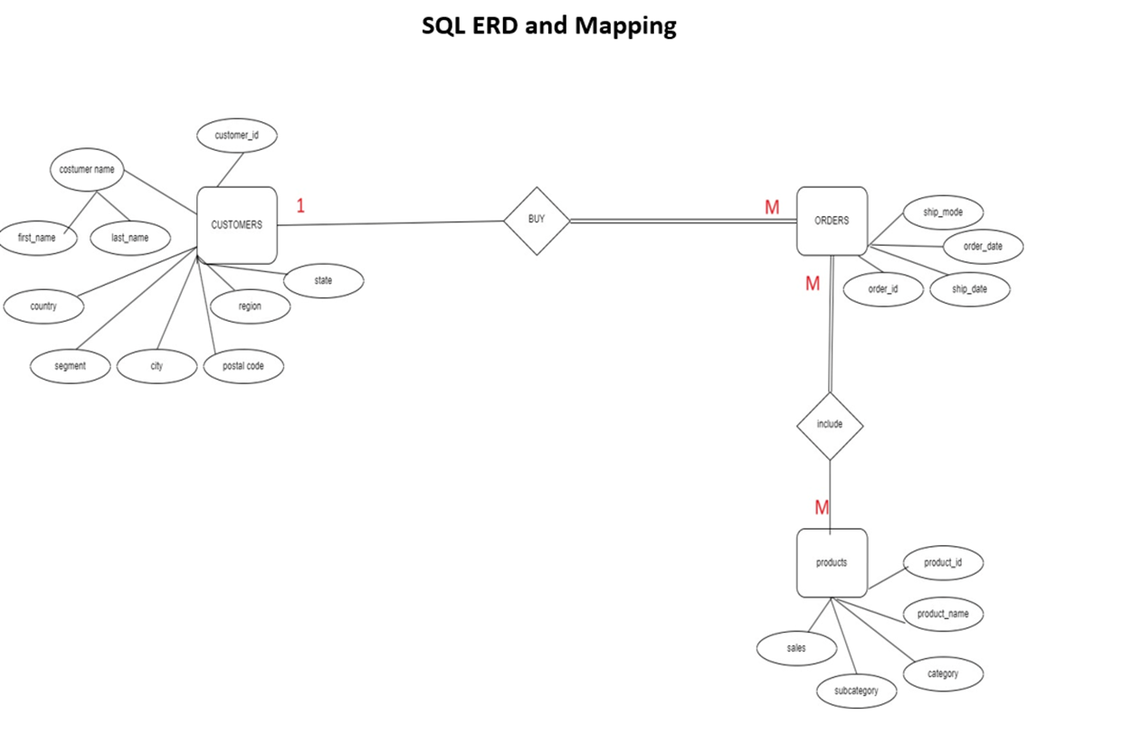
Project Overview & Objectives
Superstore Sales Data Analysis
Next Steps
Data Sources & Quality
ERD & MAPPING
Data Cleaning Process
Power BI DAX Measures
Power BI Dashboards
Key Metrics & Segments
Region and City Performance
Top Customers & Behavior
Best & Worst Products
Power BI Dashboards
Insights & Challenges

Slide 21
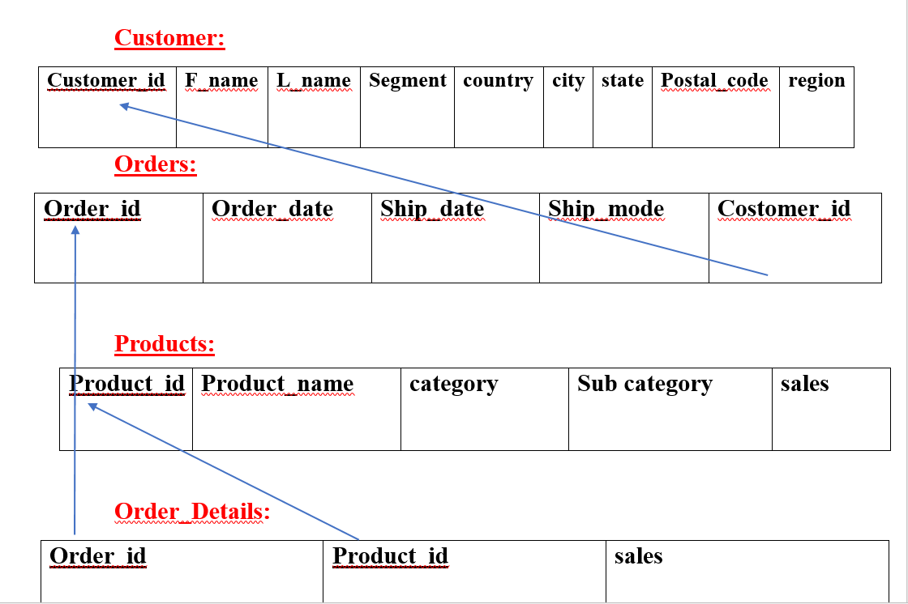
Project Overview & Objectives
Data Sources & Quality
Next Steps
Mapping
Data Cleaning Process
Power BI DAX Measures
Superstore Sales Data Analysis
Power BI Dashboards
Key Metrics & Segments
Region and City Performance
Top Customers & Behavior
Best & Worst Products
Power BI Dashboards
Insights & Challenges
Project Summary

Slide 22
Project Overview & Objectives
Data Sources & Quality
Project Summary
Data Cleaning Process
Power BI DAX Measures
Uncovered trends and segments
Identified growth opportunities
Recommended strategic actions
Ready for deeper insights
Informed by a strong dataset
Ready for business impact
Superstore Sales Data Analysis
Power BI Dashboards
Key Metrics & Segments
Region and City Performance
Top Customers & Behavior
Best & Worst Products
Power BI Dashboards
Insights & Challenges
Next Steps

Slide 23

Prepared by:
Mayar Saad Khalifa
Aml Mohamed
Mohammed Salama
Fady Makram
Ayman Elsayed Abdelhalim
Thank You

Slide 24


Thank You

